Slide 1
Large Flexible Load Taskforce
Interconnection and Planning working session
Bill Blevins
Date 06-24-2022

Slide 2
LFL-Issue 1
Develop a process for ERCOT tracking and reporting operational and planned large load interconnections.
  Concept is that Large Loads wishing to Interconnect within 2 years need to be studied sooner than normal RPG planning studies can include those loads.
  NERC FAC-002, TPL-001-5 and ERCOT planning guides require studies for addition of Load to transmission system.

Slide 3
LFL-1 Concept
When a Load > 75 MW connected to the TSP or > 20 MW connected to a Resource request to be connected and signs its agreements then the Load needs to be classified.
Loads will voluntarily designate as a Flexible Load or as firm during registration.
Loads that designate them selves as Flexible will be able to be treated as dispatchable during interconnection studies to determine their interconnection limits.

Slide 4
Benefits of selecting Flexible Load category
Thermal issues raised during Interconnection studies can recognize dispatchable nature of these flexible Loads.
Flexible Loads will be available to SCED so that in real-time these flexible Loads are able to respond to congestion similar to the redispatch in the interconnection studies.
Flexible Loads can be reduced efficiently during congestion or scarcity conditions.

Slide 5
LFLTF Definitions
Small Working Group
Bob Wittmeyer and Floyd J. Trefny
June 24, 2022

Slide 6
Topics
Definitions of:
  Large Load
  Large Flexible Load
  Non-Flexible Load (an idea)
  Large Flexible Load Resource
  Fast Curtailable Load
  Passive Load

Slide 7
Definition of a Large Load
A stand-alone Load interconnected to ERCOT greater than 75.0 MWs
A co-located load (with generation and Load) greater than 20 MWs connected to ERCOT in some fashion
A load greater than 20 MWs that nets its generation production and internal load

Slide 8
Definition of Large Flexible Load
Registered as a Load Resource (CLR)
Registered as a Load that in some way is controllable by the consumer
Load that is a Large Flexible Load Resource
Load than has the internal capability to interrupt its load and return to service as directed by ERCOT

Slide 9
Definition of Non-Flexible Load ??
Voluntarily registered as a Large Load with ERCOT
Load that in some way is controllable by the consumer
Load that is a Fast Curtailable Load
Load than has the internal capability to quickly interrupt its load but can only return to service as directed by the consumer
Load that may, but may not necessarily specify that it must return to service after a specified duration of interruption

Slide 10
Definition of Large Flexible Load Resource
A connected large load greater than 75.0 MWs that has voluntarily registered with ERCOT as a Large Flexible Load Resource and is:
  capable of operating at a ERCOT specified load level and interrupting its load if needed at a ramp rate that is greater than 10 MW per minute at any time by instruction from ERCOT without physical damage to its internal processes used by that load’s business functions;
  If dispatched by SCED, may elect to be settled at the nearest Node on the ERCOT Grid;
  and
  capable of returning to a specified load level at any time as directed by ERCOT at a specified ramp rate that is greater than 10 MWs per minute similarly without any physical damage to its internal processes used by that load’s business functions.

Slide 11
Definition of Fast Curtailable Load
A connected large load greater than 75.0 MWs that has voluntarily registered with ERCOT as a Fast Curtailable Load and:
Provides continuously telemetered load power information to ERCOT, updated every 2 seconds;
Is not considered an ERCOT Resource or is dispatched by SCED;
Is capable of interrupting its load at a ramp rate that is greater than 10% of peak MWs per minute at any time ERCOT Load Zone prices reach a telemetered price that was established by the load at the end of the Adjustment Period;
Is paid the average (over the past 4 hours) of the load’s MWh/hr consumption multiplied by a formulaic percentage of the MCPC for Non-Spin for each hour or partial hour the load remains interrupted;
and
Agrees to not return to normal load levels until so instructed by ERCOT.

Slide 12
Definition of Passive Load
A transmission or distribution load that has the ability to respond to ERCOT wholesale prices on occasion depending on the nature of their internal processes.
Passive loads purchase their energy from Retail Electric Providers or under a tariff in a non-op in Entity.

Slide 13
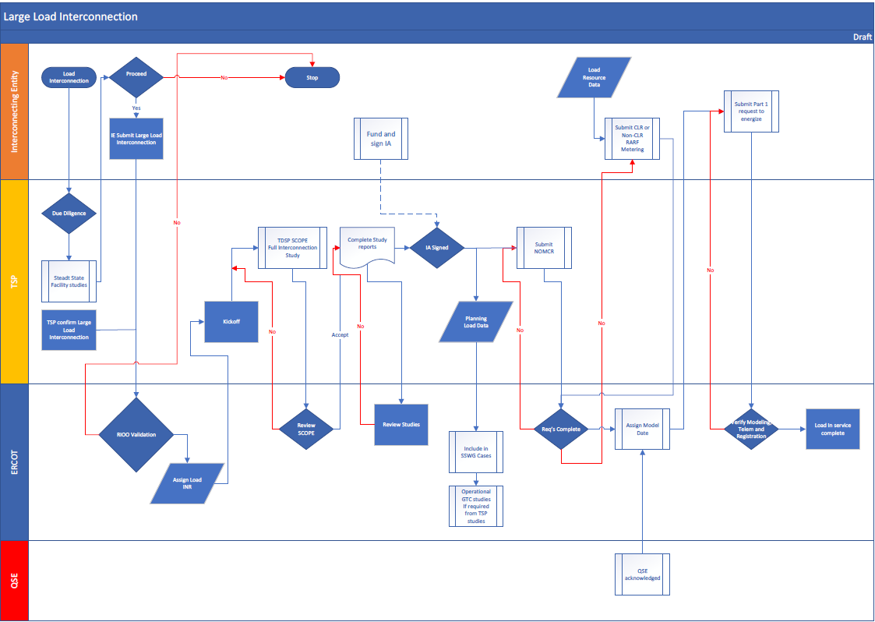
Large Load Interconnection Process

Slide 14
Comments on Process flow
Load Interconnect Request
Turn into Process box, add high level elements and time duration (1 day – 7days) for instance.
Steady State Facility Studies, add key findings reported out and time duration.
Proceed with Interconnection?
Include the additional elements of the interconnect that are being put together for submission to ERCOT along with time duration. Need to formally separate this from (1) by using Initial in (1) and Formal here if needed.
“TSP confirm Large Load Interconnection” what is this and why is it here? Is it supposed to be a decision box where ERCOT verifies the interconnect request? If so, put it in a diamond in the main path with a no pointing to “stop” and yes proceeding.
RIOO Validation, needs to be a question, need overview of requirements to pass and timeframe for review. I would prefer this to be an operation box instead, with a “Criteria met” decision box below it. Yes proceeds, and No should go back to the Load or TSP to obtain the needed information not just stop, correct?
New action box in the line going up to Kickoff where ERCOT reports INR in “Load Interconnect Study” list

Slide 15
Comments on Process flow
Kickoff meeting should have brief overview and involves the load and the TSP, so should extend up into the load section.
TDSP SCOPE FIS – add key needs if possible and time duration
SCOPE Complete? Specific criteria should be linked in some way to the box. “No” arrow should point to box not line. Other line should be “Yes” not accept.
Complete Study reports? When did the study take place? Here? If so, box should be process “Full Interconnect Study” with time expectation and key elements produced.
ERCOT’s “Review Studies” box. They just look at it and provide no feedback? What if ERCOT doesn’t like it? Should there be a decision box here where ERCOT approves prior to the IA being signed?
IA signed should be moved up to include the Load and the TSP. Should include “funding” unless there is a reason to keep them separate. If so, there should be a box added.

Slide 16
Large Load Interconnection Process
May 24th this process was discussed at LFLTF
It was requested that the flowchart include more detail.
To date we have updated the flowchart to include comments supplied.
Its proposed that we start writing the Planning revision to incorporate the Large Load Interconnection.
Its proposed we add detail to this process flow as the language is developed where needed so that the flowchart reflect a high level outline.

